Slide 1
Analyzing Expert Twitter Accounts on Cybersecurity by Utilizing Thesaurus Methods for Text Analytics
Qianwen Chen, Shruti Bakare, Aditee Verma, Christopher Casasanta, Christian White Andreea Cotoranu, and Avery Leider .
Seidenberg School of CSIS, Pace University, Pleasantville, New York
{qc26641n, sb85060n, av11813n, cc54700n, cw02322p, acotoranu, aleider} @pace.edu

Slide 2
Problem Statement
Perform text analytics on the twitter data to build a thesaurus of cybersecurity concepts
By selecting the top experts in the field and analyzing their text, we are able to build a thesaurus of expert related cybersecurity terms
In this study, we have considered 70,115 tweets from 25 expert users

Slide 3
Objectives
Primary steps to create the thesauri are:
Identify 25 frequent twitter users that can be classified as “Cybersecurity experts”.
Compile the tweets of each user into a CSV file; each account will have its own file. Combine these files into one “dataset”.
Run text analysis on each user’s data set using two preprocessing methods:
Python Module
RapidMiner
Split data set from Python into two groups
Run frequency analysis on each group using TF-IDF method
Compare TF-IDF results to discover text similarities among experts.

Slide 4
Identify cybersecurity experts on Twitter
GROUP A - 37,807 Tweets | GROUP B - 32,308 Tweets
@Cyber | @CLTCBerkeley
@NJCybersecurity | @NISTcyber
@NortonOnline | @DarkReading
@TheCyberSecHub | @threatintel
@symantec | @McAfee
@CheckPointSW | @PaloAltoNtwks
@TrendMicro | @Fortinet
@Stanford_Cyber | @proofpoint
@Incapsula_com | @CyberArk
@avgaunz | @Gemalto
@LifeLock | @ManTech
@splunk | @VERISIGN
@digicert

Slide 5
Extraction of tweets
Identify 25 cybersecurity experts of twitter
Create 25 separate csv file for each user
Extract all the tweets they posted uptill
Using the python library called tweepy
Once the 25 expert twitter accounts were collected, the next step was to extract all the tweets
For accessing the twitter API, we used the python library called Tweepy

Slide 6
Processing Data Using Python
Twitter text messages are very noisy, unstructured and contains symbols, links, emoticons, etc.
To extract information from tweets, we need to transform those inappropriate words into standard form
According to those problems, pre-processing tasks are very important and critical in text mining
Pre-processing aims to eliminate noises from the text data
We have incorporated Natural Language Toolkit(NTLK) which is a suite of python libraries and programs as well as Pandas software library for creating the program

Slide 7
Python Libraries Used
The Natural Language Toolkit, or more commonly NLTK, is a suite of libraries and programs for symbolic and statistical natural language processing for English written in the Python programming language
In computer programming, Pandas is a software library written for the Python programming language for data manipulation and analysis

Slide 8
Data Processing keywords
Stop words: These are the words that are common and serve no purpose in determining meaning, such as “an”, “the”, or “of”
Tokenization: It is the act of breaking up a sequence of strings into pieces such as words, keywords, phrases, symbols and other elements called tokens
Part-of-Speech(pos) tagging: Identifying words as nouns, verbs, adjectives, adverbs etc.
Lemmatization: It is the process of grouping together the inflected forms of a word so they can be analyzed as a single item, for ex: ‘finds’ and ‘found’ are the inflicted forms of ‘find’

Slide 9
Workflow of data processing using Python
CSV file of the cybersecurity expert user twitter feed
Make each tweet lower case
Cleaning data
Remove Unicode
Remove twitter usernames
Remove Numbers
Remove single letters
Removes: rt, via, &, ICYMI
Tokenize the Tweets
Part-of-Speech tagging and Lemmatize
Remove stop words

Slide 10
Workflow of data processing using Python
Add word in frequency list
If word already exist in frequency list, increment the number
Sort the frequency list
Reverse the order
Print this list in a CSV file

Slide 11
Top 25 Frequency List for the user @Threatintel
Rank | Word | Frequency
1 | infosec | 520
2 | cybersecurity | 400
3 | security | 235
4 | attack | 233
5 | malware | 219
6 | ransomware | 201
7 | data | 152
8 | device | 149
9 | vulnerability | 124
10 | privacy | 118
11 | tech | 118
12 | threat | 116
13 | scam | 108
14 | patch | 106
15 | wannacry | 101
16 | email | 100
17 | update | 95
18 | android | 93
19 | user | 90
20 | history | 88
21 | symantec | 84
22 | tip | 83
23 | attacker | 81
24 | cyber | 81
25 | read | 77

Slide 12
Processing Data Using RapidMiner
RapidMiner is a data science software platform that provides an integrated environment for data preparation, machine learning, deep learning, text mining, and predictive analytics.
RapidMiner is written in the Java programming language and provides a GUI to design and execute analytical workflows. Those workflows are called “Processes” in RapidMiner and they consist of multiple “Operators”.
Each operator performs a single task within the process, and the output of each operator forms the input of the next one.
RapidMiner provides learning schemes, models and algorithms and can be extended using R and Python scripts.

Slide 13
Workflow of Data processing using RapidMiner
Loading CSV file of the cybersecurity expert user twitter into RapidMiner
Generates a data set from each CSV documents
Input documents
Find text attribute
Add meta information
Datamanagement
Tokenize the Tweets
Transforms all characters into lowercases
Output data table
Select the mode to non letters
Splitting the document into sentences
Set English for POS tagger

Slide 14
Workflow of Data processing using RapidMiner
Filter Stopwords
Filter tokens by length
Output the word frequency table
Removes English stopwords
Apply and remove stopword from given file
Generate n-Grams(Terms)

Slide 15
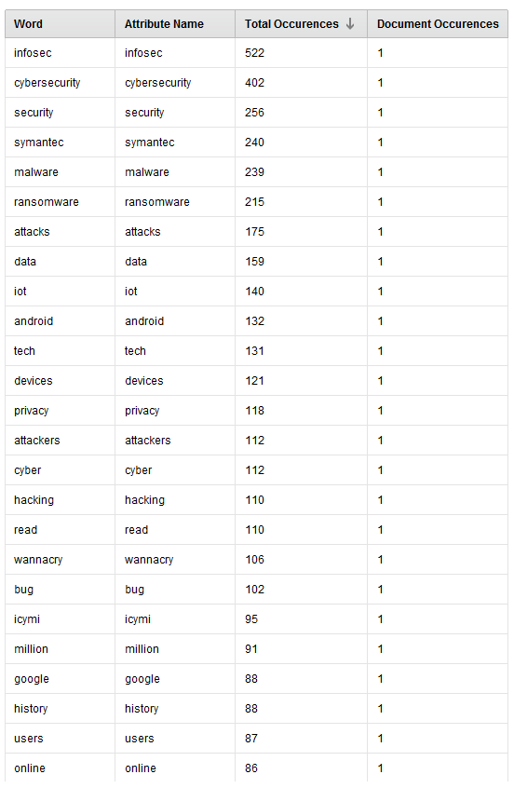
Top 25 Frequency List for the user @Threatintel

Slide 16
Comparing Python and RapidMiner Results
Python | RapidMiner
Lemmatization is possible in python | Lemmatization is not possible using RapidMiner in our case
Users can view the output using csv or excel file | Users can view the output only within the application
Using python we can analyze large amount of data using paying anything | Cannot analyzes large dataset unless we pay for the extra functions
Hence, Python is better than RapidMiner | RapidMiner is less efficient

Slide 17
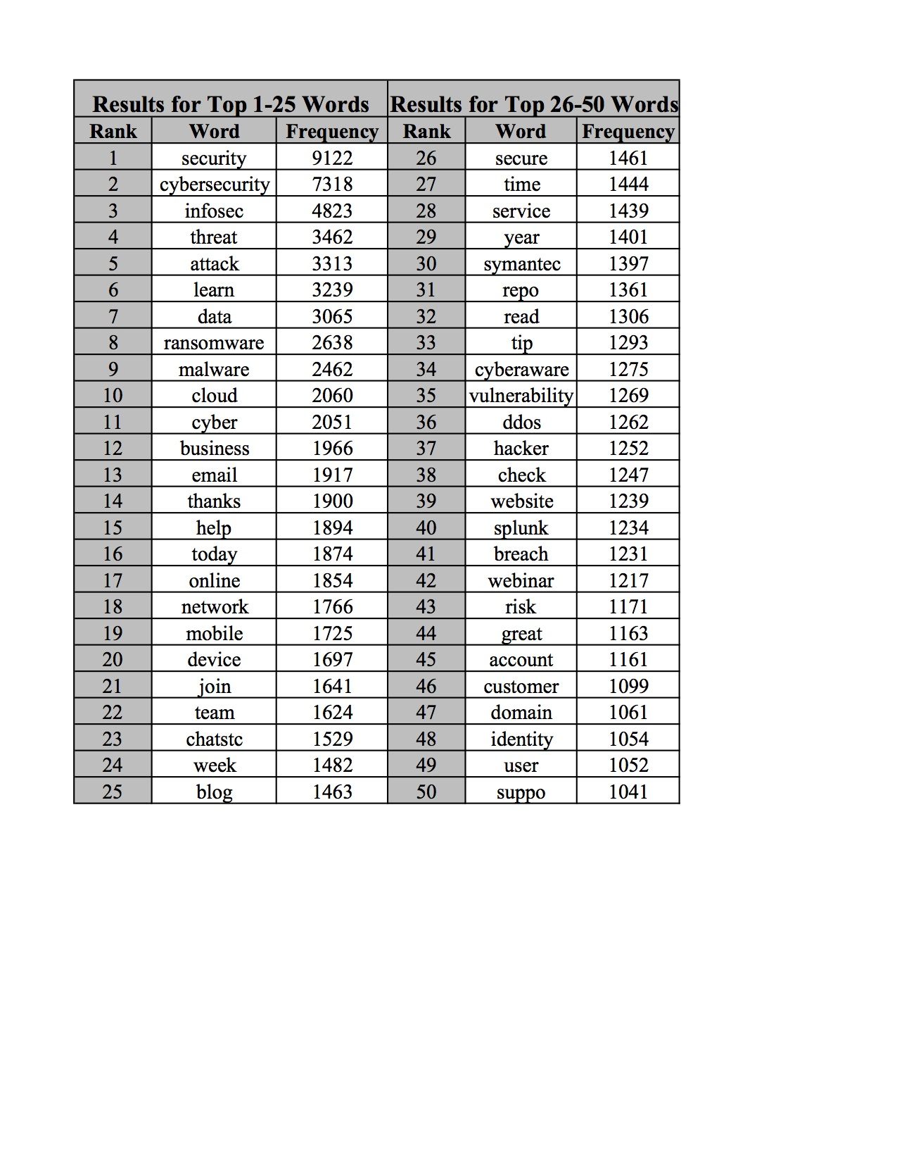
Result A: Thesaurus based on Frequency
Based on the disadvantages of RapidMiner, it was decided to continue the analysis using Python
Therefore, all 25 profiles were merged into one .csv file, to create a data set

Slide 18
TF-IDF
TF-IDF is a numerical statistic that is intended to reflect how important a word is to a document in a collection or corpus. It’s value increases proportionally to the number of times a word appears in the document and is offset by the frequency of the word in the corpus
TF(t) = (Number of times term t appears in a document) / (Total number of terms in the document)
IDF(t) = log_e(Total number of documents / Number of documents with term t in it)
Example: Consider a document containing 100 words wherein the word cybersecurity appears 3 times. The term frequency (i.e., tf) for cat is then (3 / 100) = 0.03. Now, assume we have 10 million documents and the word cybersecurity appears in one thousand of these. Then, the inverse document frequency (i.e., idf) is calculated as log(10,000,000 / 1,000) = 4. Thus, the Tf-idf weight is the product of these quantities: 0.03 * 4 = 0.12

Slide 19
TF-IDF: Next Steps
The TF-IDF applied in Python adds a level of sophistication to the frequency analysis that will increase the number of actual expert related terms received and minimize the common and typical cybersecurity terms
To prove the study was successful and able to create the accurate expert dictionary, several tests using TF-IDF were performed
Next slides will demonstrate how we applied TF-IDF over our datasets to get relevant results

Slide 20
Study A: Comparing the two dataset with TF-IDF method
Group A which consisted of 13 users and totaled 37,807 tweets and then Group B which contained 12 users and totaled 32,308 tweets
Once all the .csv files for each group were merged, the data was processed with Python using the TF-IDF method
The output looked something like below:
 | Group A | Group B
account | 0.014146 | 0
ale | 0 | 0.014146
alto | 0.014146 | 0
android | 0.014146 | 0
attack | 0 | 0
blog | 0.014146 | 0
breach | 0 | 0
business | 0 | 0
call | 0 | 0.014146
chatstc | 0 | 0.014146
check | 0 | 0
cloud | 0.014146 | 0
customer | 0.014146 | 0

Slide 21
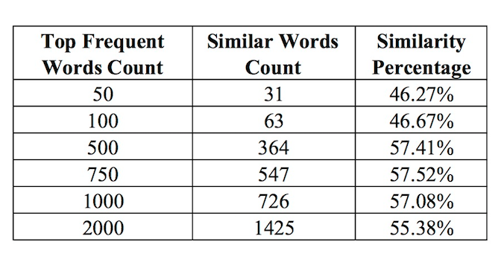
Study A: Comparing the two dataset with TF-IDF method
After comparing all the words for Group A and Group B, a total of 20866 words were found. This analysis obtained a similarity word count of 6567. The percentage of the similarity between the two groups is 31.47%.
In order to identify patterns in the data, this study experimented with different numbers of words as shown in the Table below. This study achieved the highest similarity percentage of 57.52% with the top 750 words

Slide 22
Result B: Thesaurus using TF-IDF
Used Study A to determine which terms belongs to the thesaurus by taking those terms that are in the top frequencies of multiple lists
For example, Table on the right shows the 31 words that occur in both Group A and Group B from Similarity table of study A
These words are deemed relevant due to their appearance in both groups

Slide 23
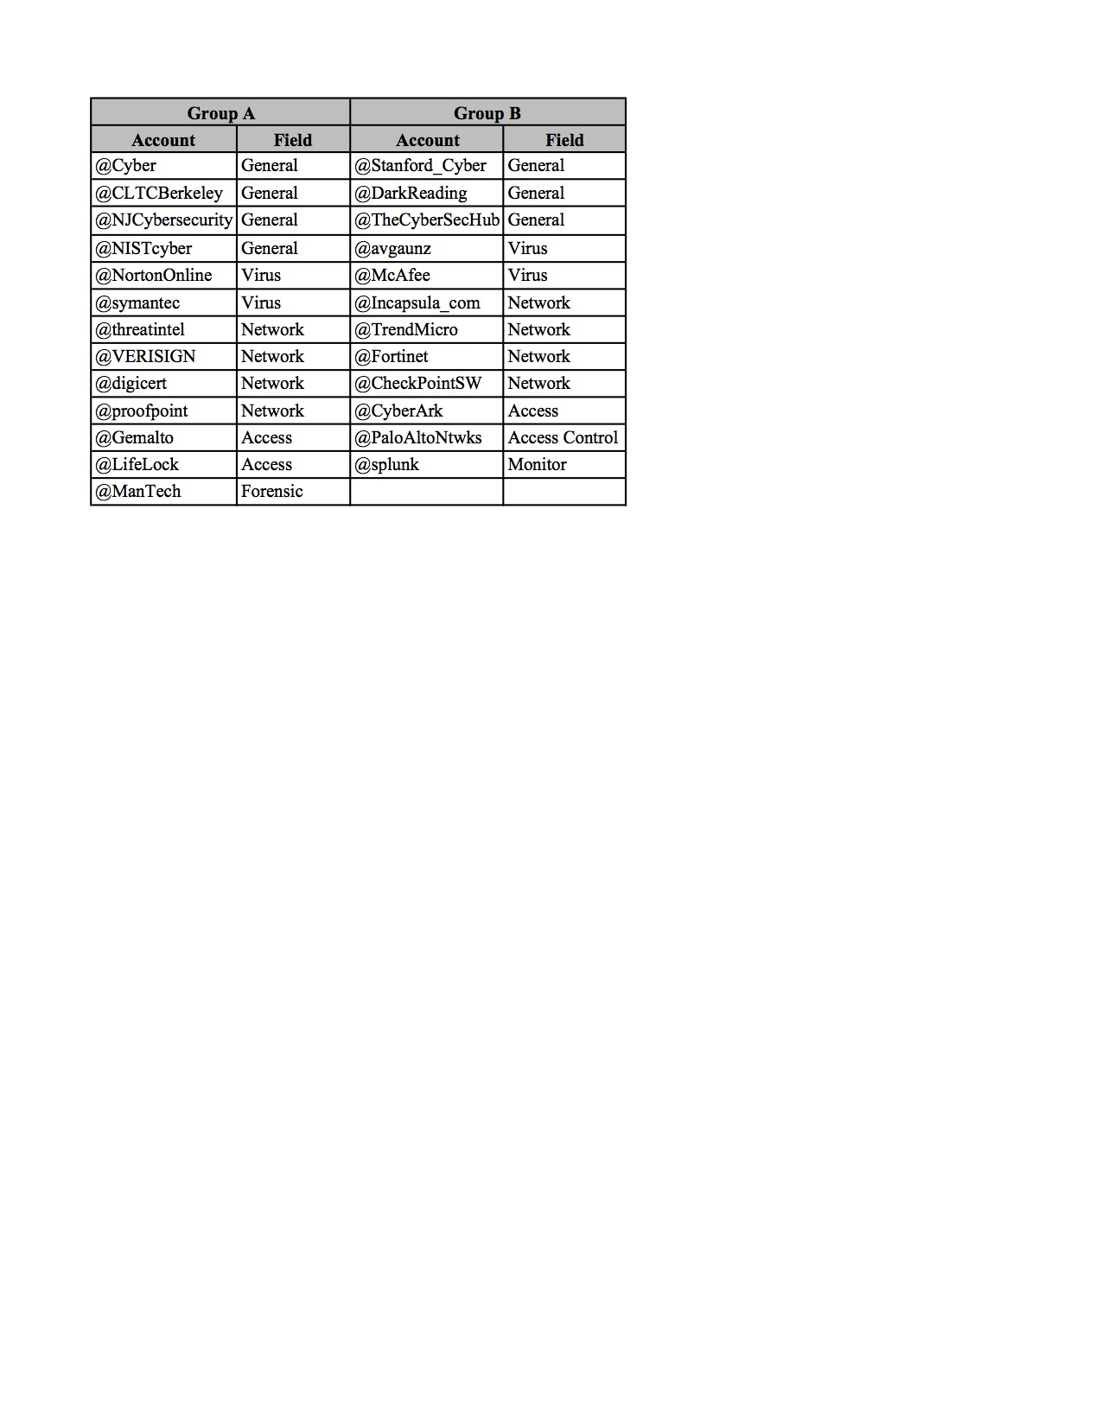
Study B: Comparing the two dataset with TF-IDF method
In this study, the 25 profiles were split into group A and group B by evenly distributing the experts based on the sub-fields represented by each profile as shown in below table:

Slide 24
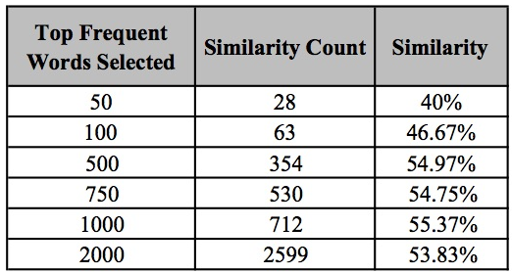
Study B: Comparing the two dataset with TF-IDF method
These new groups were compared using the same method, providing the results shown in Table below
The results are similar when comparing the percentage with last study

Slide 25
Study C: Comparing 25 datasets using TF-IDF method
Another method for obtaining a thesaurus using TF-IDF was also researched
In this study, the top 20 frequent words of each of the 25 cybersecurity experts were gathered, making the total word count 500 words. A TF-IDF ‘score’ for these 25 documents was then computed. In order to calculate this ‘score’, a python module called “tfidfdocuments.py” was developed.
The higher the ‘score’, then the more important the word. After running the 25 documents through the Python program, the highest TF-IDF score came out to “0.12629”. 40 total words with the high score were chosen. The words are shown in next slide.

Slide 26
Result C: Thesaurus by Comparing 25 datasets using TF-IDF method
Scam | Site | Framework | Priviledged
Password | Bot | Incident | Credential
Spam | Trap | Advisory | Access
User | ProofPoint | Crime | Analytics
Safe | Fraud | Privilege | Devops
Microsoft | Compliance | Crash | Botnet
Mobilesecurity | Visibility | Breach | Lifelock
Host | Malicious | Contact | System
Master | Splunk | Authentication | Task
Cyberark | Share | Webperf | Order

Slide 27
Did we find the Solution to the Problem Statement? – YES!! ☺
Our Study demonstrated that preprocessing can be used on a corpus of Tweets to build a thesaurus on a specific topic
Text analysis and frequency analysis that was performed on a data set of over 70,000 Tweets was able to show a high percentage of similarities among all 25 “expert” users. Even though each user was different and had their own record with thousands of Tweets, the analysis was able to pick out the cybersecurity related terms that they tweeted most about and then use that information to determine which of these words were important to this analysis, and which ones were “noise.”
As a result, this study generated three highly filtered thesaurus of expert cybersecurity related words

Slide 28
Did we find the Solution to the Problem Statement? – YES!! ☺
The final products are the data driven thesaurus that can be used to identify a Twitter user as an expert or non-expert based upon the content of their Tweets
With reference to the approach of calculating the similarity percentage using TF-IDF, researchers can also set up a certain number for the similarity percentage, for example if the similarity percentage is around or above 50%, then assume it is a cybersecurity expert

Slide 29
Summary of Project Meetings
Every week we meet with our customer to make sure we are on the right path and to gain more understanding on our upcoming tasks
Mode of communication for meetings is Skype
For day to day communication we use Slack
Our team is divided into two sub teams: the writing experts and the coding experts. The sub teams meet regularly to complete the weekly tasks
We maintain all the python modules and csv files over github: https://github.com/averma74/Text-Analytics

Slide 30
References
[1] Bonzanini, M. (2017, July 19). Mining Twitter Data with Python (Part 1: Collecting data). Retrieved February 13, 2018, from https://marcobonzanini.com/2015/03/02/mining-twitter-data-with-python-part-1/
[2] Cognitive Performance Group, July 24, 2013. “4 Differences Between Experts and Novices” http://cognitiveperformancegroup.com/2013/07/24/4-differences-experts-novices/#respond accessed Feb 10, 2018.
[3] Dalal M and Zaveri, M, "Automatic Text Classification: A Technical Review," Semantics Scholar, 2011.
[4] Danushka Bollegala, Member, IEEE, David Weir and John Carroll, “Cross-Domain Sentiment Classiﬁcation using a Sentiment Sensitive Thesaurus”,2013
[5] Divya, F, “Real Time Sentiment Classification Using Unsupervised Reviews”, IJIRCCE, March 2014.
[6] Fiore, V, Almodovar, K, Assoumou, A, Dutta, D, and Cotoranu, A, “The Correlation between the Topic and Emotion of Tweets through Machine Learning.” IEEE, May 2017.
[7] Hidayatullah. A and Ma’arif. M 2017 “Pre-processing Tasks in Indonesian Twitter Messages”J. Phys.: Conf. Ser. 801 012072
[8] Hofmann. M, Klinkenberg. R, “RapidMiner: Data Mining Use Cases and Business Analytics Applications (Chapman & Hall/CRC Data Mining and Knowledge Discovery Series),” CRC Press, October 25, 2013.
[9] Jivani, A. Nov, 2011. “A Comparative Study of Stemming Algorithms”, https://pdfs.semanticscholar.org/1c0c/0fa35d4ff8a2f925eb955e48d655494bd167.pdf . Accessed Feb 20, 2018.

Slide 31
References
[10] Norris. D, “RapidMiner - a potential game changer,” Bloor Research, November 13, 2013.
[11] Ross, K. G., Phillips, J. K., Klein, G., & Cohn, J. (2005). “Creating expertise: A framework to guide technology-based training”, accessed Feb 10, 2018.
[12] Srivastava. T, September 4, 2014. “Framework to build a niche dictionary for text mining” https://www.analyticsvidhya.com/blog/2014/09/creating-dictionary-text-mining/ accessed Feb 10, 2018.
[13] TextMiner. July 09, 2015. “Dive Into NLTK, Part III: Part-Of-Speech Tagging and POS Tagger”, http://textminingonline.com/dive-into-nltk-part-iii-part-of-speech-tagging-and-pos-tagger . Accessed Feb 19, 2018
[14] TFIDF, http://www.tfidf.com/. Accessed Mar 24, 2018
[15] Twitter Usage Statistics. http://www.internetlivestats.com/twitter-statistics/. Accessed April 16, 2018.
[16] Wu. H and Luk. R and Wong. K and Kwok. K. "Interpreting TF-IDF term weights as making relevance decisions". ACM Transactions on Information Systems, 26 (3). 2008.
[17] Verma. T, Renu, Gaur D. April 2014, “Tokenization and Filtering Process in RapidMiner”, http://research.ijais.org/volume7/number2/ijais14-451139.pdf accessed Feb 20, 2018.
[18] Vincent Fiore, Sukhjinder Nahal, Dmitry Matyunin, Emma Padilla, Jaikishin Satpal, and Andreea Cotoranu. “Generating a Cybersecurity Thesaurus Based On Tweets”, http://vinnyfiore.com/Group%206%20Paper.pdf . Accessed Feb 08, 2018.
[19] Expert System, Apr 18, 2016. “10 Text Mining Examples” http://www.expertsystem.com/10-text-mining-examples/ accessed Apr 18, 2018.

Slide 32
Thank You

